Slide 1
Chapter 4
File Systems
4.1 Files
4.2 Directories
4.3 File system implementation
4.4 Example file systems

Slide 2
File Systems (1)
Many important applications need to store more information than have in virtual address space of a process
The information must survive the termination of the process using it.
Multiple processes must be able to access the information concurrently.

Slide 3
File Systems (2)
Disks are used to store files
Information is stored in blocks on the disks
Can read and write blocks

Slide 4
File Systems (3)
Use file system as an abstraction to deal with accessing the information kept in blocks on a disk
Files are created by a process
Thousands of them on a disk
Managed by the OS

Slide 5
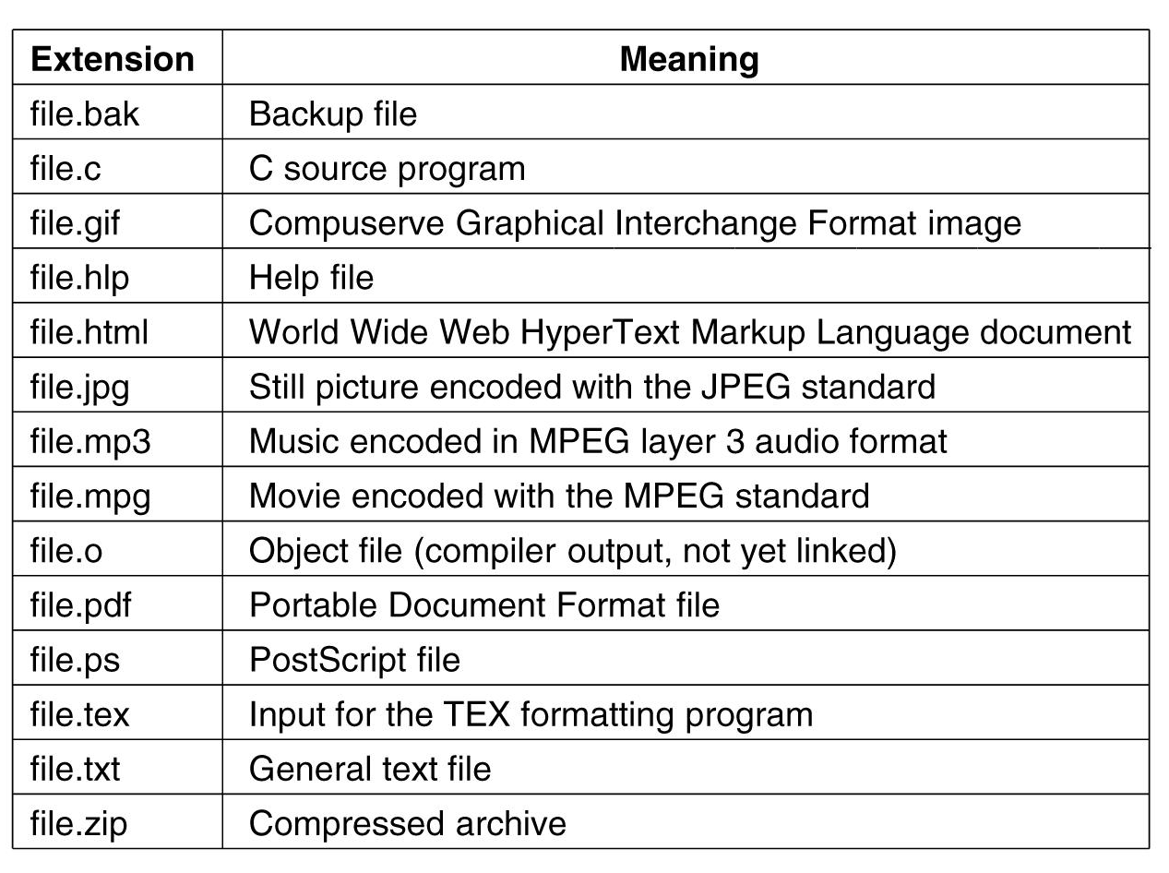
File naming
.

Slide 6
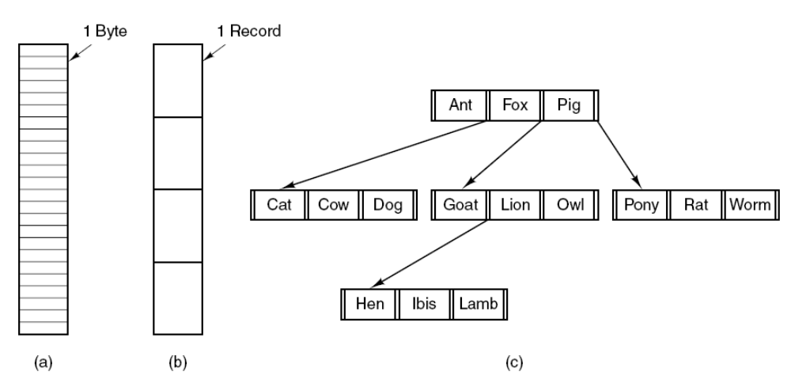
File Structure
Three kinds of files. (a) Byte sequence.
(b) Record sequence. (c) Tree.

Slide 7
File Types
Regular- contains user information
Directories
Character special files- used to model serial (e.g. printers) I/O devices
Block special files-used to model disks

Slide 8
Regular Files
ASCII or binary
ASCII
  Printable
  Can use pipes to connect programs if they produce/consume ASCII

Slide 9
Binary File Types
Two Unix examples
  Executable (magic field identifies file as being executable)
  Archive-compiled, not linked library procedures
Every OS must recognize its own executable

Slide 10
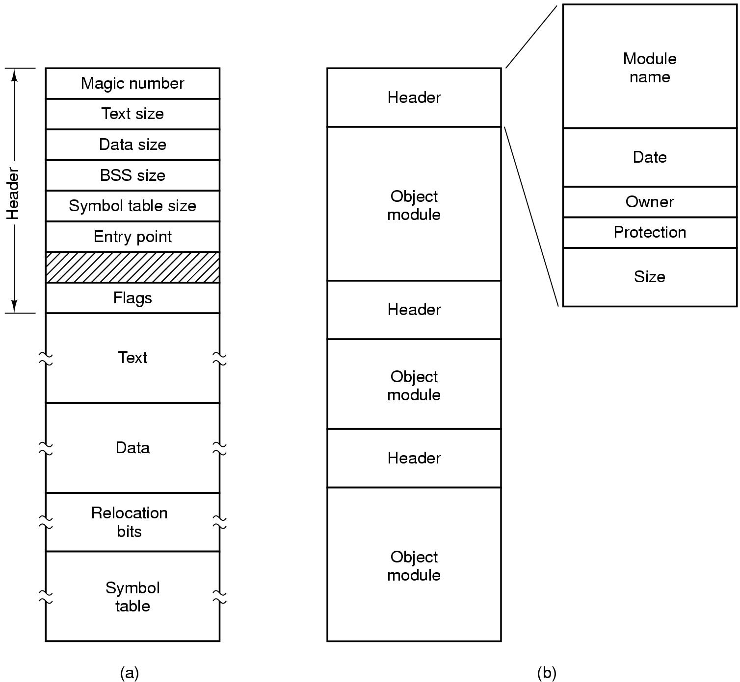
Binary File Types (Early Unix)
(a) An executable file. (b) An archive file.

Slide 11
File Access
Sequential access- read from the beginning, can’t skip around
  Corresponds to magnetic tape
Random access- start where you want to start
  Came into play with disks
  Necessary for many applications, e.g. airline reservation system

Slide 12
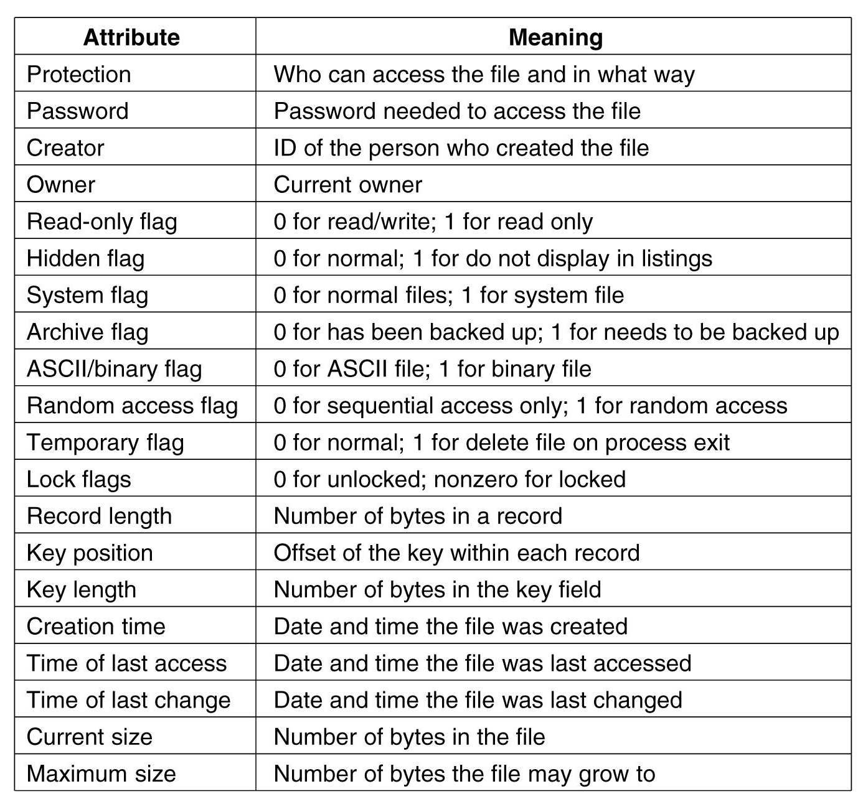
File Attributes (hypothetical OS)

Slide 13
File Operations
  Create
  Delete
  Open
  Close
  Read
  Write
  Append
  Seek
  Get attributes
  Set Attributes
  Rename

Slide 14
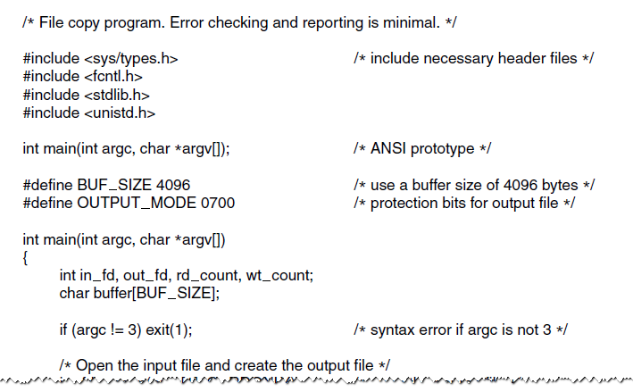
Example Program Using File System Calls (1)
A simple program to copy a file.

Slide 15
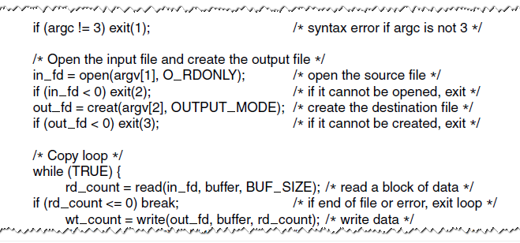
Example Program Using File System Calls (2)
A simple program to copy a file.

Slide 16
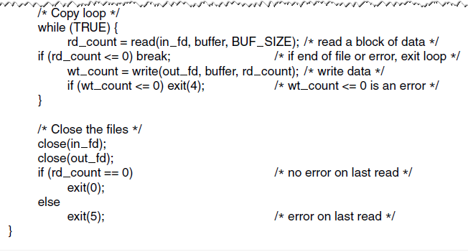
Example Program Using File System Calls (3)
A simple program to copy a file.

Slide 17
Directories
Files which are used to organize a collection of files
  Also called folders in weird OS’s

Slide 18
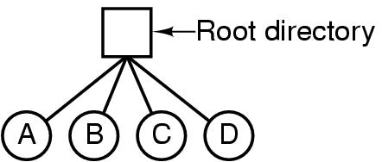
Single Level Directory Systems
A single-level directory system containing four files.

Slide 19
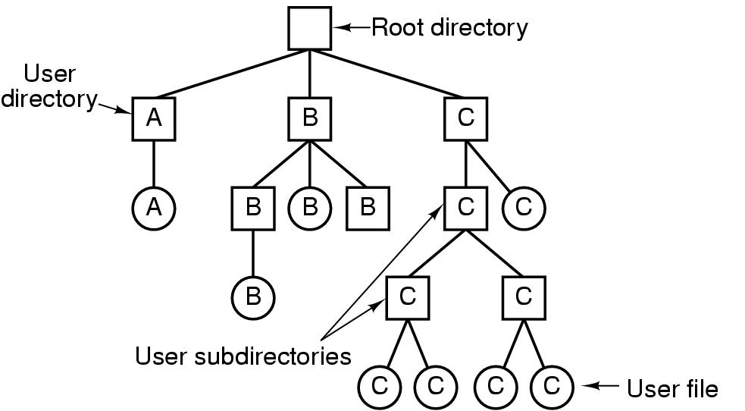
Hierarchical Directory Systems

Slide 20
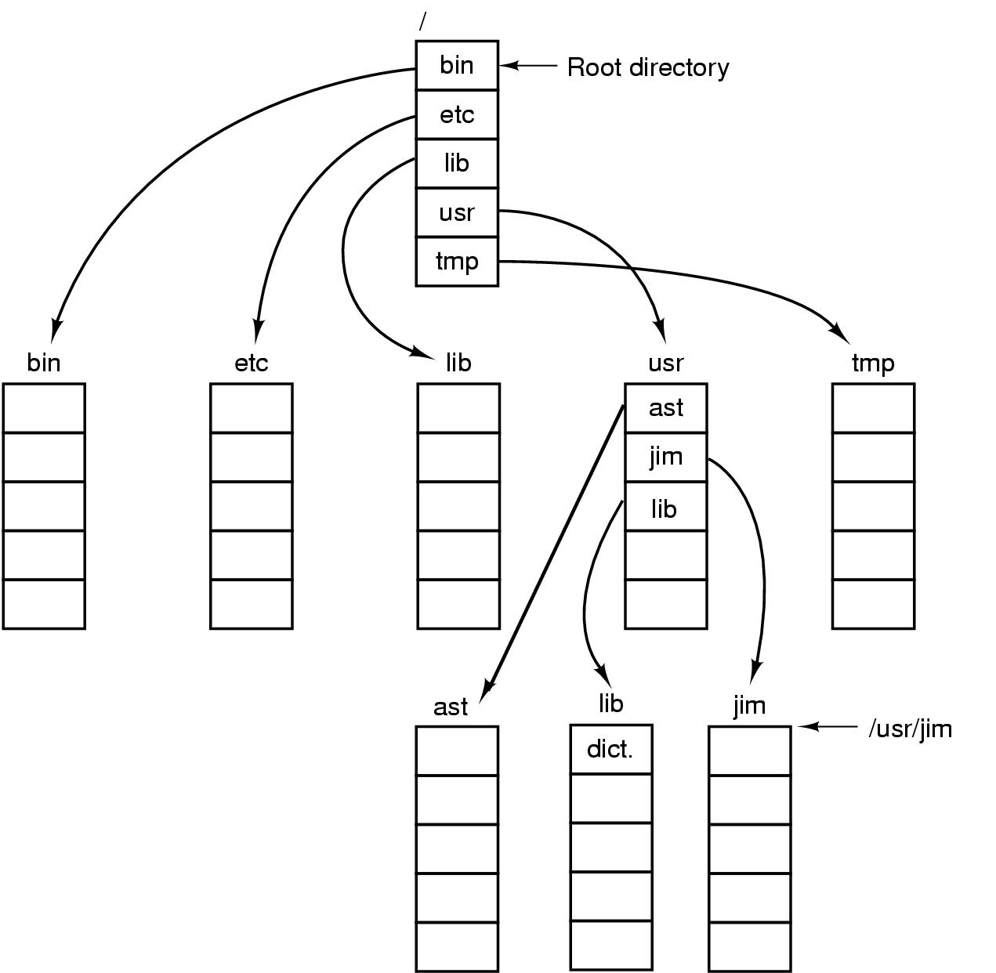
Path Names
A UNIX directory tree.

Slide 21
Directory Operations
Create
Delete
Opendir
Closedir
Readdir
Rename
Link
Unlink

Slide 22
File System
Implementation

Slide 23
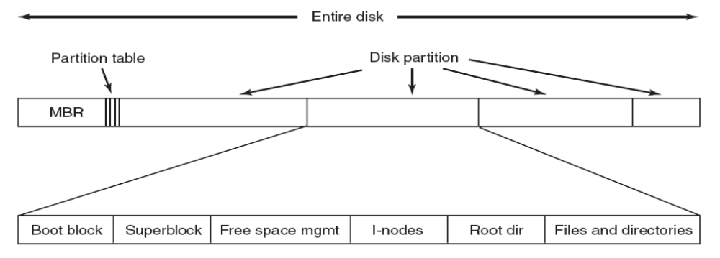
A Possible File System Layout
MBR = Master Boot Record

Slide 24
Implementing files
Most important implementation issue
Methods
  Contiguous allocation
  Linked list allocation
  Linked list using table
  I-nodes

Slide 25

Contiguous Allocation (1)
(a) Contiguous allocation of disk space for 7 files.
(b) The state of the disk after files D and F have been removed.

Slide 26
Contiguous Allocation (2)
The good
Easy to implement
Read performance is great. Only need one seek to locate the first block in the file. The rest is easy.
The bad-disk becomes fragmented over time
CD-ROM’s use contiguous allocation because the fs size is known in advance

Slide 27
Linked List Allocation (1)
Each file is a linked list of disk blocks: blocks may be scattered anywhere on the disk.
Simple – need only starting address
Free-space management system – no waste of space
No random access
block =
pointer

Slide 28

Linked List Allocation (2)
Storing a file as a linked list of disk blocks.

Slide 29
Linked List Allocation (3)
The good
Gets rid of fragmentation
The bad
Random access is slow. Need to chase pointers to get to a block

Slide 30
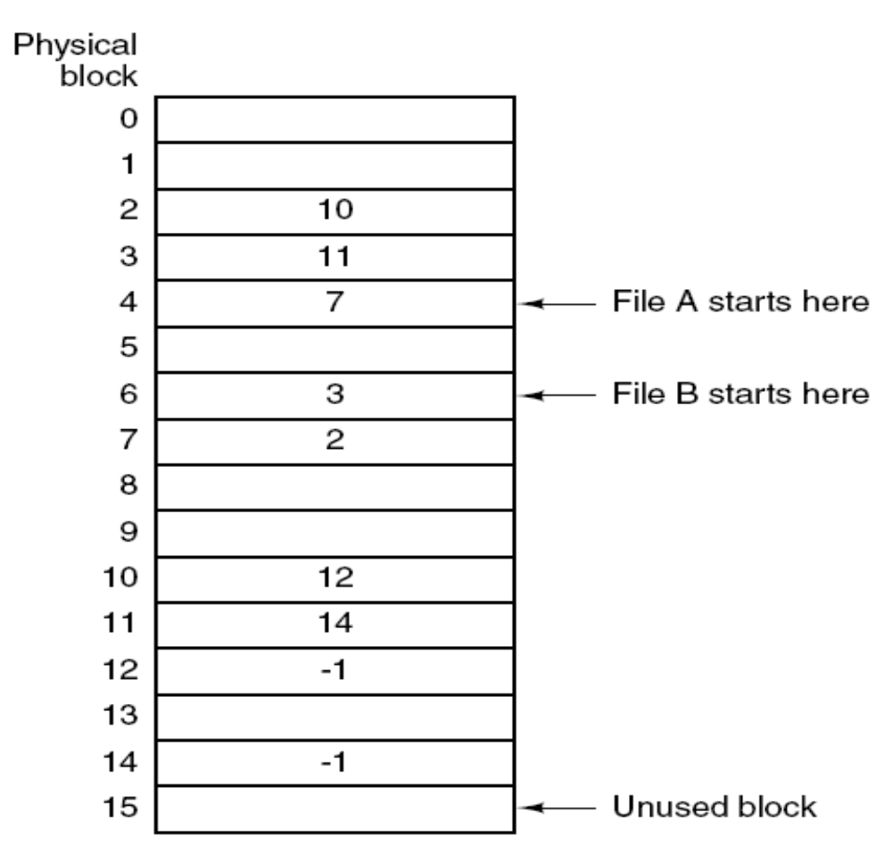
Linked lists using a table in memory (1)
Both disadvantages of the linked-list allocation can be eliminated by taking the pointer word from each disk block and putting it in a table in memory.
File A uses disk blocks 4, 7, 2, 10, and 12, in that order, and file B uses disk blocks 6, 3, 11, and 14, in that order.
Linked-list allocation using a file-allocation table in main memory (FAT).

Slide 31
Linked lists using a table in memory (2)
The bad: table becomes really big
The table for holding the linked list of all disk blocks is proportional in size to the disk itself. If the disk has n blocks, the table needs n entries. As disks grow larger, this table grows linearly with them.

Slide 32
I-node (1)
This method uses a data structure called i-node (index-node) for keeping track of which blocks belong to which file. The big advantage of this scheme over linked files using an in-memory table is that the i-node need be in memory only when the corresponding file is open. If each i-node occupies n bytes and a maximum of k files may be open at once, the total memory occupied by the array holding the i-nodes for the open files is only kn bytes.

Slide 33
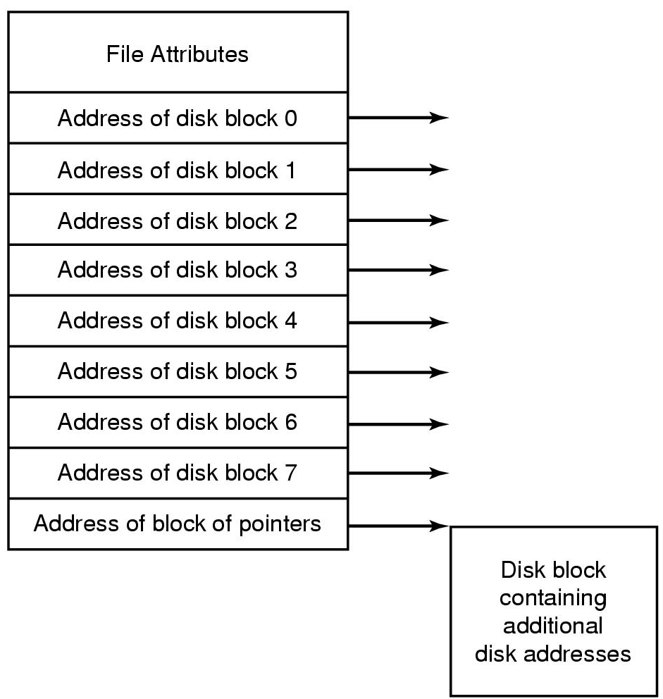
I-node (2)
The i-node scheme requires an array in memory whose size is proportional to the maximum number of files that may be open at once. It does not matter if the disk is 100 GB, 1000 GB, or 10,000 GB.
Each i-node:
describes one file
accounting info (owner and protection bits)
provides the address information for all blocks in the file...

Slide 34
I-node (3)
How big is N?
Solution: Last entry in table points to disk block which contains pointers to other disk blocks

Slide 35
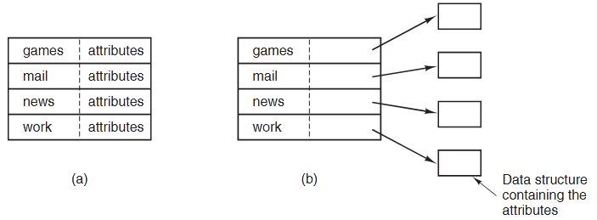
Implementing Directories (1)
In the simple design, a directory consists of a list of fixed-size entries, one per file, containing a (fixed-length) file name, a structure of the file attributes, and one or more disk addresses (up to some maximum) telling where the disk blocks are.
(a) A simple directory: fixed size entries, disk addresses and attributes in directory entry
(b) Directory in which each entry just refers to an i-node

Slide 36
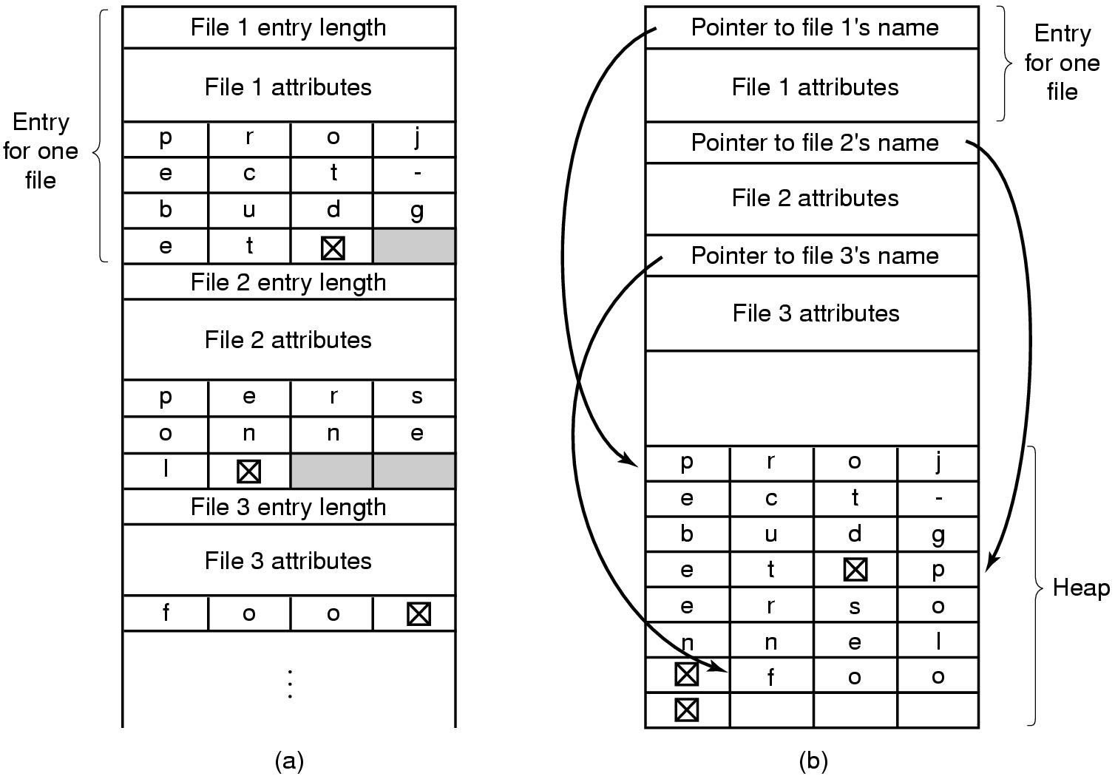
Implementing Directories (2)
Two ways of handling long file names in directory
  (a) In-line
  (b) In a heap

Slide 37
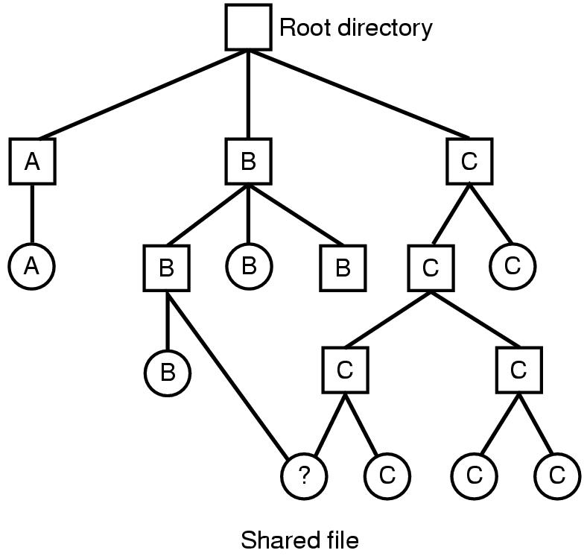
Shared Files (1)
File system containing a shared file

Slide 38
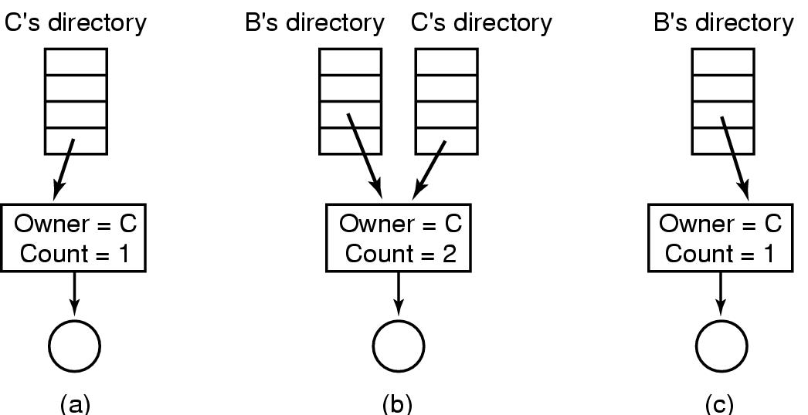
Shared Files (2)
(a) Situation prior to linking
(b) After the link is created
(c)After the original owner removes the file

Slide 39
File System Management
and Optimization

Slide 40
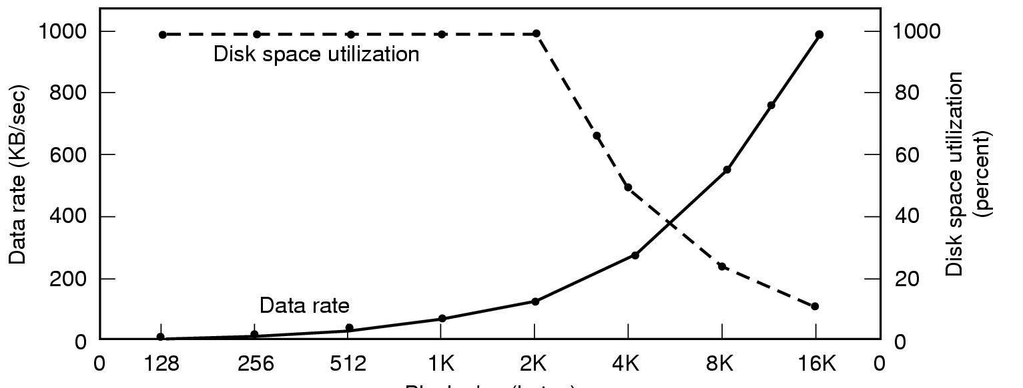
Disk Space Management – Block size
Block size
- Dark line (left hand scale) gives data rate of a disk
- Dotted line (right hand scale) gives disk space efficiency
- All files 2KB
What the curves show, how ever, is that performance and space utilization are inherently in conflict. Small blocks are bad for performance but good for disk-space utilization.

Slide 41
Disk Space Management
Keeping Track of Free Blocks (1)
Once a block size has been chosen, the next issue is how to keep track of free blocks. Two methods are widely used, as shown in next slide. The first one consists of using a linked list of disk blocks, with each block holding as many free disk block numbers as will fit.
The other free-space management technique is the bitmap. A disk with n blocks requires a bitmap with n bits. Free blocks are represented by 1s in the map, allocated blocks by 0s (or vice versa).

Slide 42
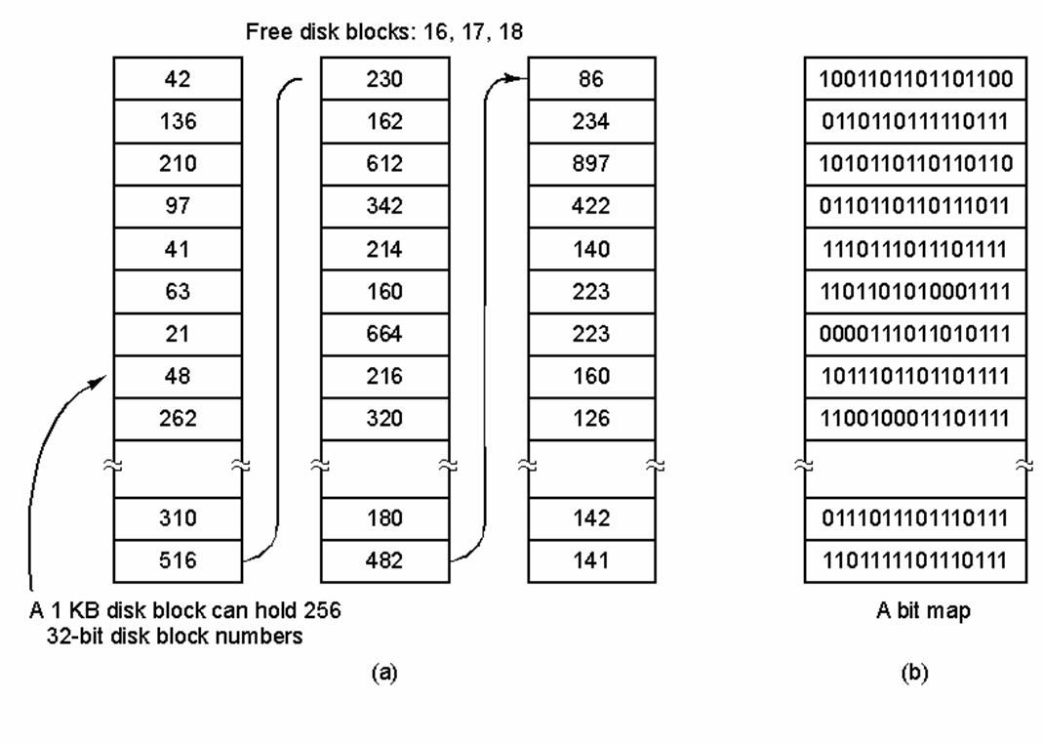
Disk Space Management
Keeping Track of Free Blocks (2)
(a) Storing the free list on a linked list
(b) A bit map

Slide 43
Example File Systems

Slide 44
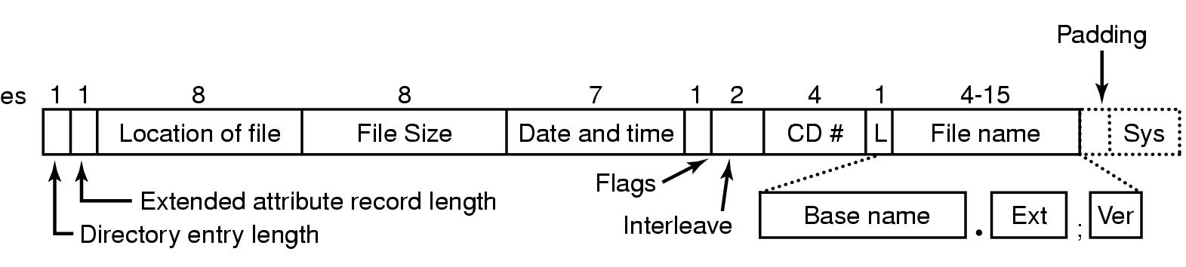
Example File Systems
CD-ROM File Systems
The ISO 9660 directory entry

Slide 45
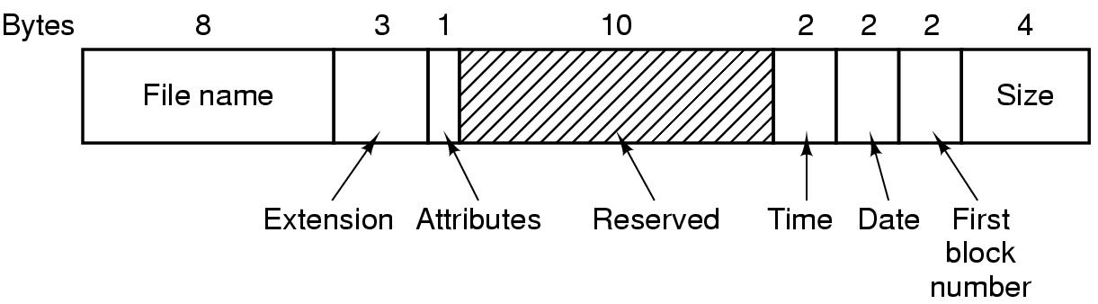
The MS-DOS File System (1)
The MS-DOS directory entry

Slide 46
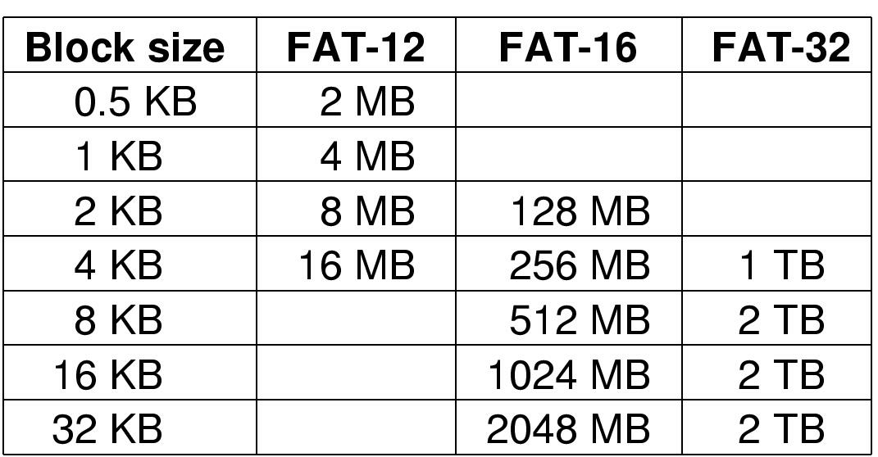
The MS-DOS File System (2)
Maximum partition for different block sizes
The empty boxes represent forbidden combinations

Slide 47
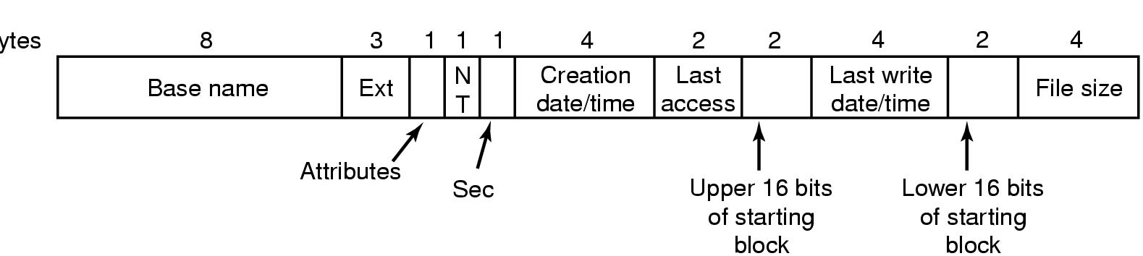
The Windows 98 File System (1)
Bytes
The extended MOS-DOS directory entry used in Windows 98

Slide 48
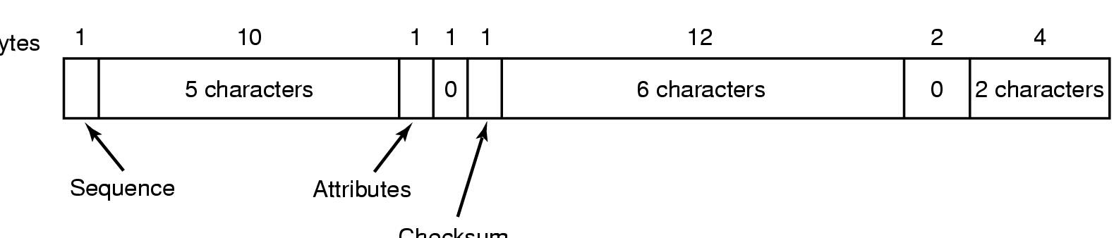
The Windows 98 File System (2)
Bytes
Checksum
An entry for (part of) a long file name in Windows 98

Slide 49
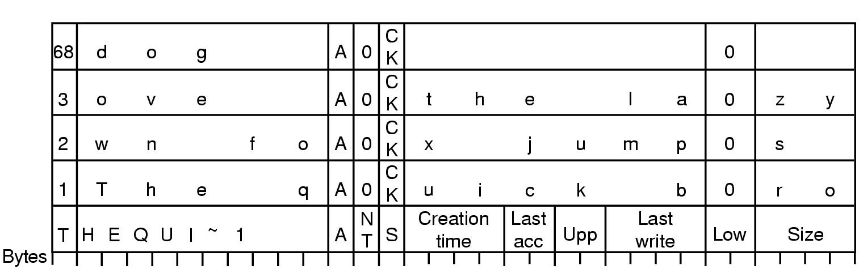
The Windows 98 File System (3)
An example of how a long name is stored in Windows 98

Slide 50
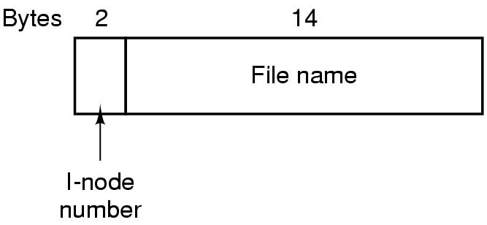
The UNIX V7 File System (1)
A UNIX V7 directory entry

Slide 51
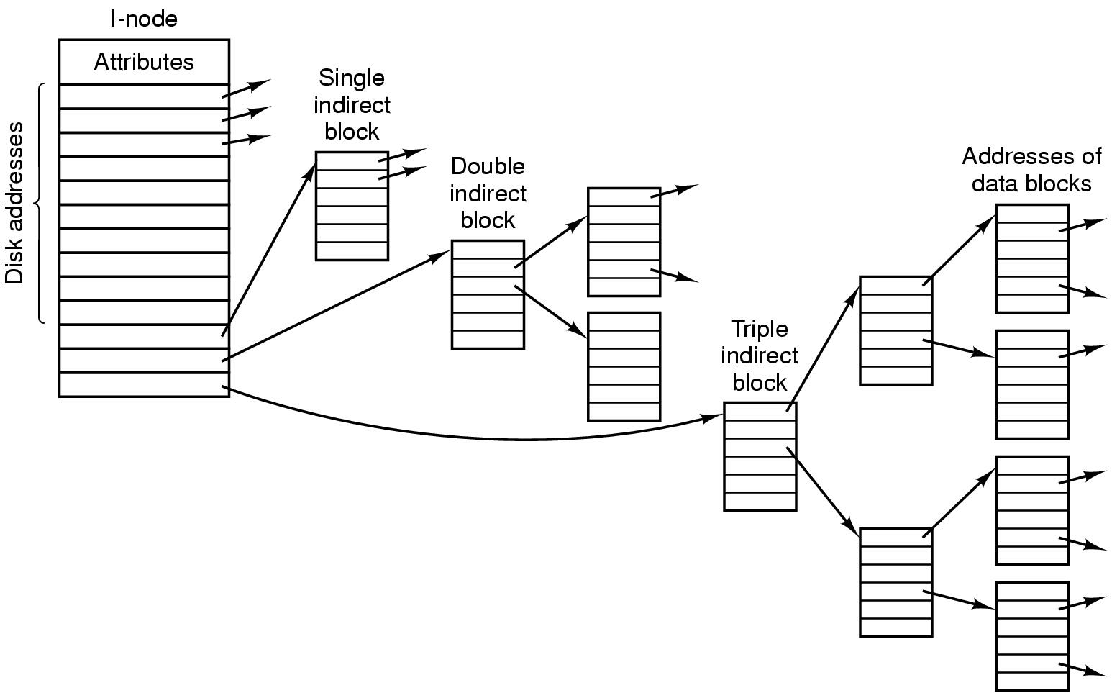
The UNIX V7 File System (2)
A UNIX i-node

Slide 52
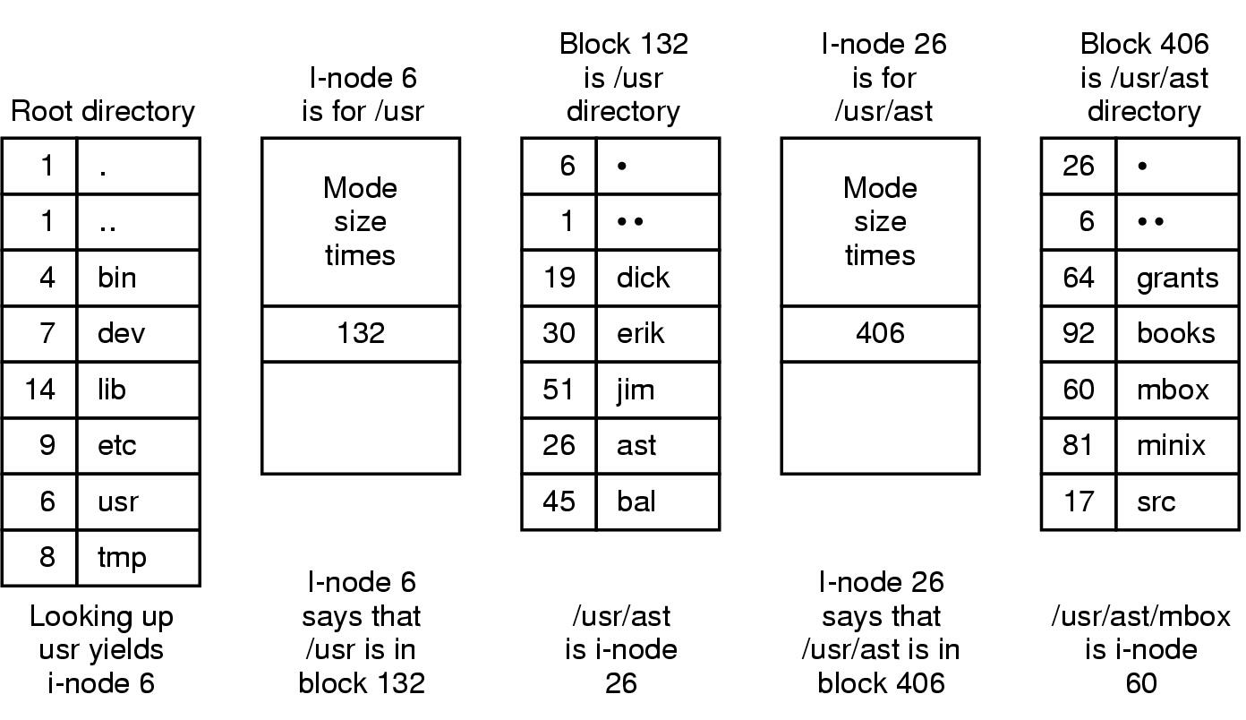
The UNIX V7 File System (3)
The steps in looking up /usr/ast/mbox

